Slide 1
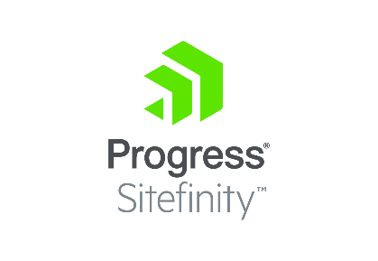

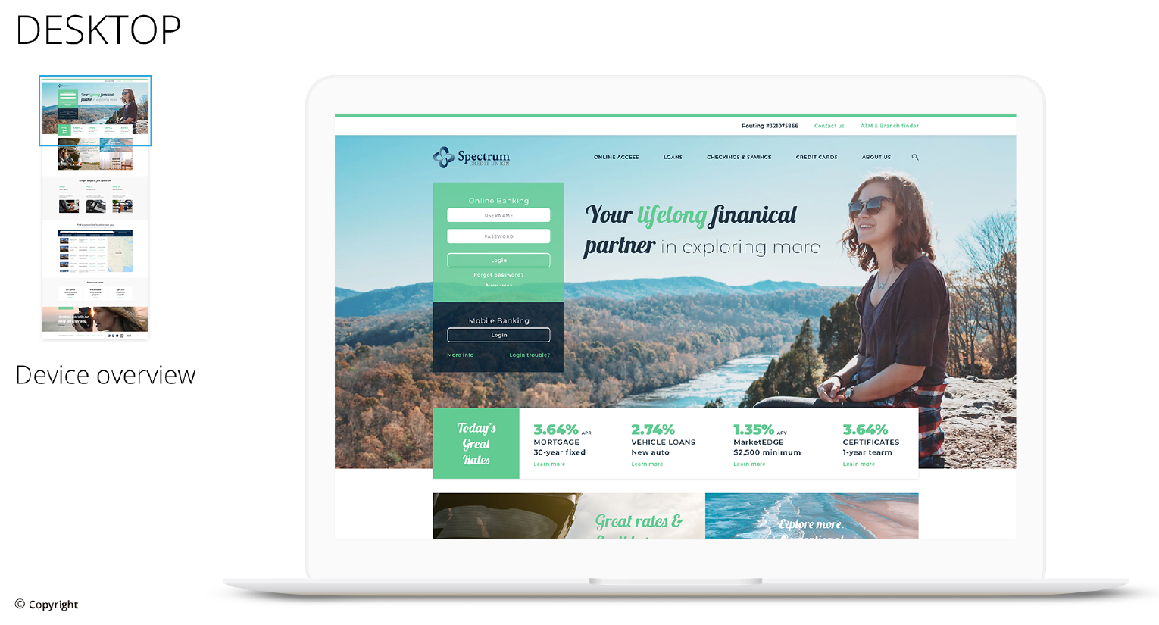
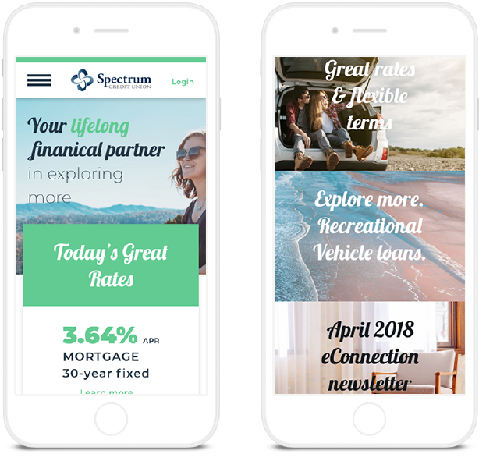
Chevron
Business Need Chevron Federal Credit Union is a long term customer who came to us looking for a redesign for their current websites, Chevron Federal Credit Union and their branded site Spectrum. They were working with a different vendor who did not build out the Sitefinity backend to best practices, which caused the Marketing Group (who owns the site), the huge pain point of having to involve a developer every time they wanted to make even simple changes to the websites.
What We Did Affirma’s Creative Team first created two design concepts, and from there iterated CFCU’s top pick. Affirma’s development team first built out the Spectrum Site and then duplicated the site, changing the colors and branding to Chevron for the second site. The sites went live at the end of August and the Marketing group is now able to make changes to the site, using Sitefinity’s flexible backend widgets, rather than relying on a developer to make code changes. Affirma continues supports both their websites with a managed service for further enhancements and overall health of the sites.
Results
https://www.chevronfcu.org/
https://www.spectrumcu.org/

